Slide 1
Should I Contact MISS DIG 811 When I’m Only Hand-Digging/Using Non-Mechanical Tools?
Notes:
At MISS DIG 811, we’re often asked by homeowners & even professional excavators if they are required to call in a dig notice to our Notification Center when they will only be hand-digging, or using non-mechanical tools to do their work on a property.

Slide 2
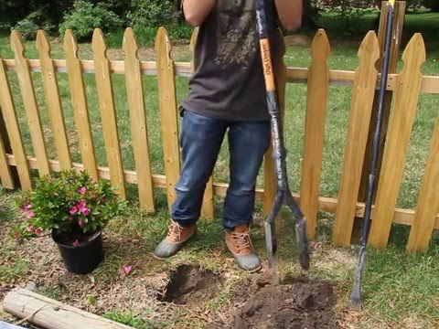
Notes:
Our answer is always an emphatic yes! We recommend that you should always play it safe & contact MISS DIG 811 when you will be digging, excavating or simply disturbing the ground….even if you will only be using a shovel or post hole digger to plant bushes, shrubs, a garden, or to install fence or deck posts.

Slide 3
CFR 196 – Protection of Underground Pipelines from Excavation Activity
Excavation covers all excavation activity involving both mechanized and non-mechanized equipment, including hand tools.
Prior to and during excavation activity, the excavator must:
(a) Use an available one-call system before excavating to notify operators of underground pipeline facilities of the timing and location of the intended excavation
Per Code of Federal Regulations Title 49; Part 196
Notes:
Despite the fact that Public Act 174, better known as the MISS DIG law, is based around the use of power tools or power equipment, you are still required to place a dig notice even if you will only be using some form of soft excavation, including hand digging. Per Title 49, Part 196 of the Code of Federal Regulations, excavation covers all excavation activity involving both mechanized and non-mechanized equipment, including hand tools, & requires that the excavator place a dig notice with the one-call system in their area. Why is this so important? First, each year a big portion of utility damage happens when this type of work is occurring on a property, and that costs the utility & the excavator who caused the damage time & money to repair. More importantly, calling in a dig notice & having your utilities marked can save lives.

Slide 4
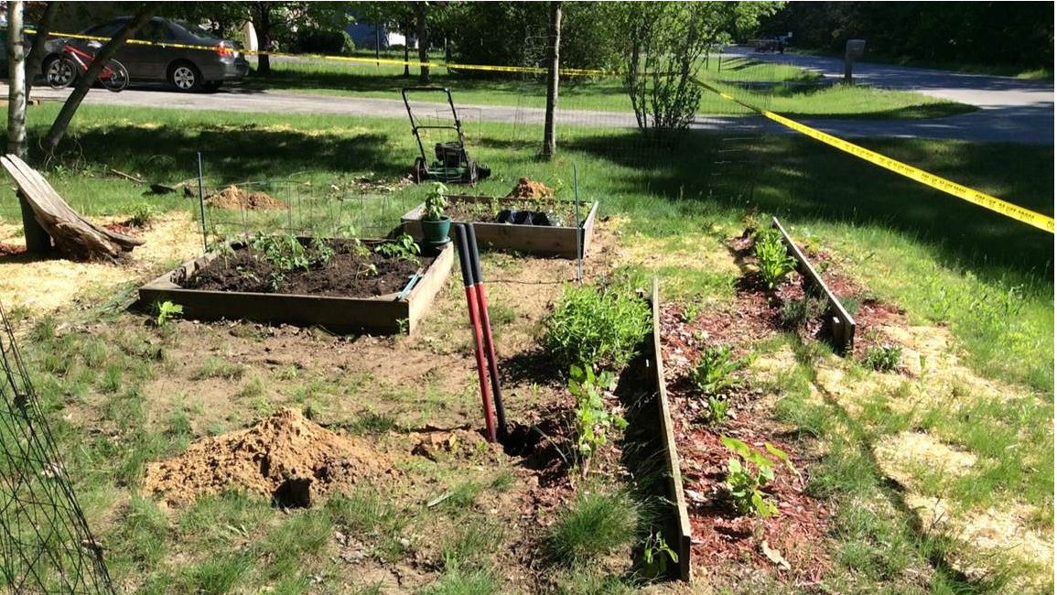
Notes:
Take this example sent to us by MISS DIG 811 member Cherryland Electric Co-operative in Northern Michigan. A homeowner was installing t-posts and digging post holes for a garden fence right along Cherryland’s high-voltage primary underground electrical. The homeowner did not bother to call in a dig notice to MISS DIG 811, as he was only using non-mechanical tools to do the work, and felt confident that there would be no conflict with any underground utility lines. The homeowner was wrong. He didn’t hit anything while pounding the t-posts, but was digging up this post hole, when he thought he found a root less than 3 ft below surface.

Slide 5
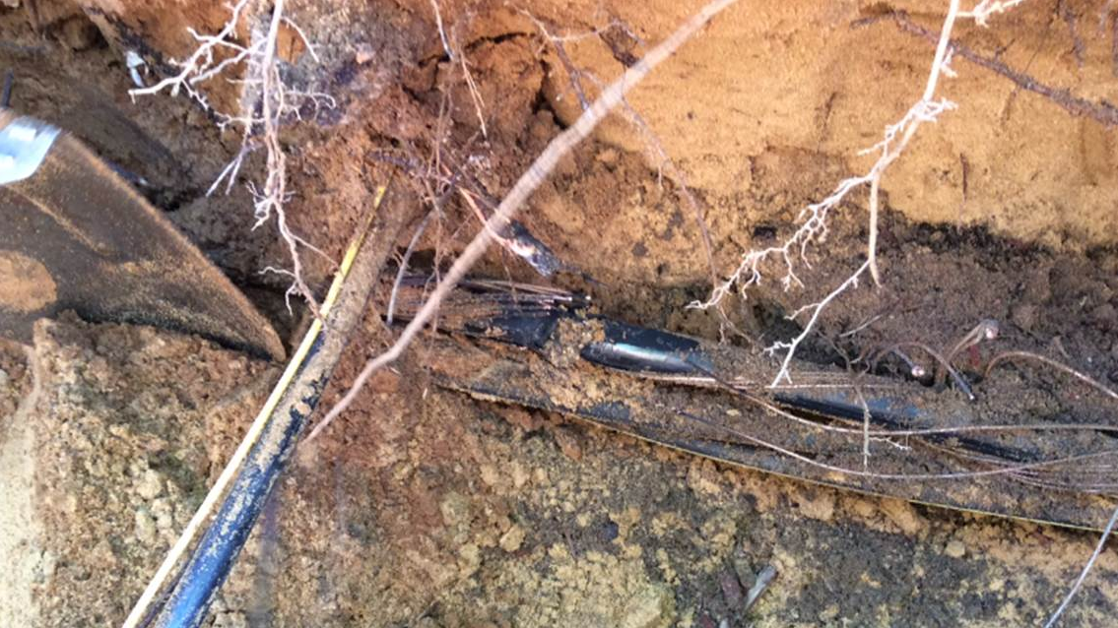
Notes:
He gave what he thought to be a large tree root a stab with his post hole digger and instead severed the insulation on this 7,200 volt underground electric line. There was also secondary triplex under the primary that was not damaged by the fault and could have still been energized after the initial outage. He missed the gas service to his home in this same hole by less than 4 inches!

Slide 6
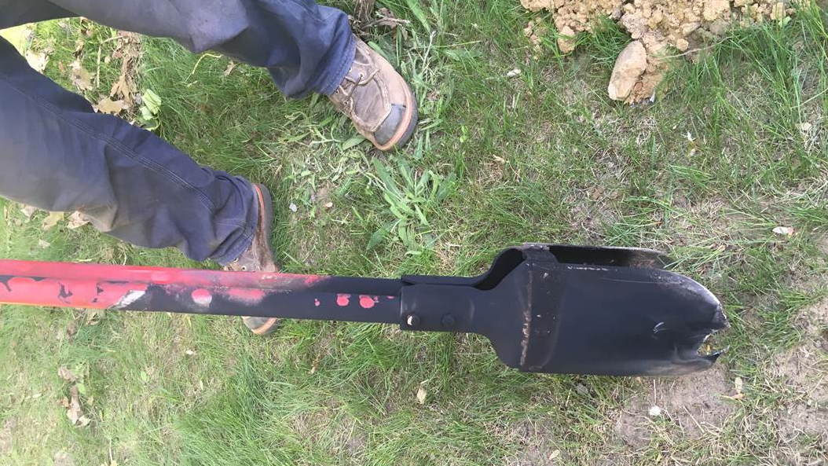
Notes:
The high-voltage line arced and burned a good hole in his digger, as shown here, and he received a flash burn on his arms and face. Luckily, the fiberglass-handled post hole digger that was used did insulate him from the primary voltage and he wasn’t shocked or killed! It’s important to note that fiberglass tools should not be considered insulated unless rated, tested, and inspected at every use by qualified electrical workers. There were also clear signs that there were utilities in the area, as his work all took place 30 ft south and in plain sight of the padmount transformer at his property corner.

Slide 7
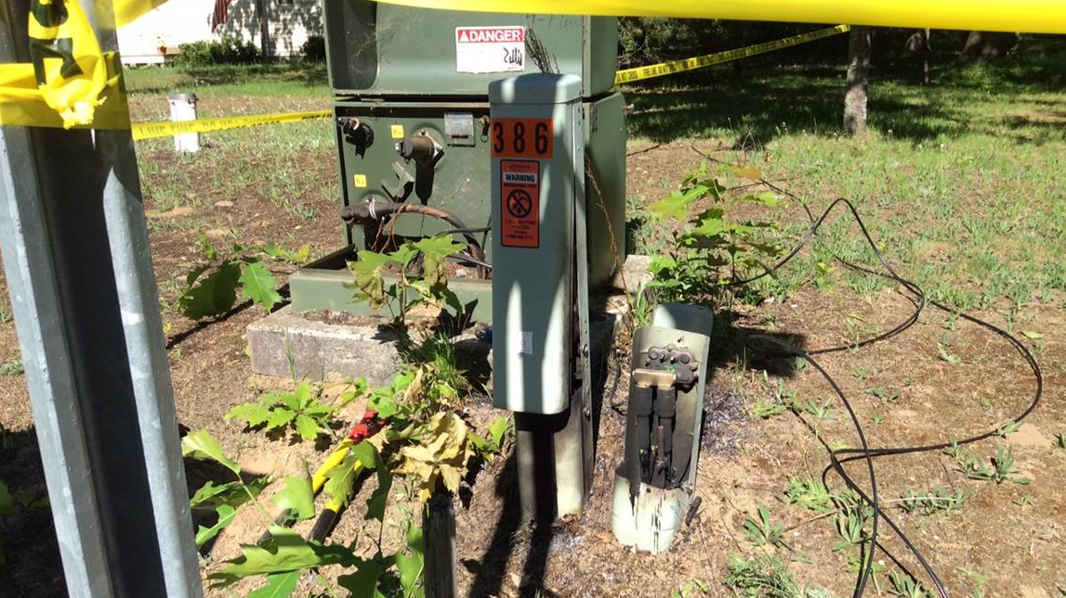
Notes:
As a result, the cable tv line also picked up some ground fault current, and the lid on the cable TV ped was blown off and started a small grass fire.

Slide 8
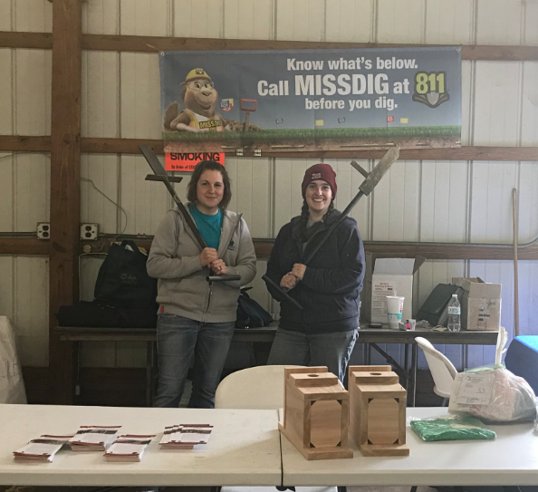
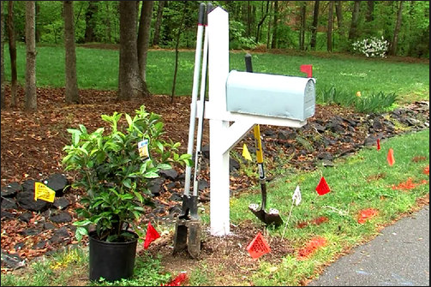
Know What’s Below! Contact MISS DIG 811!
It’s fast!
It’s free!
It’s the law!
Notes:
Remember to know what’s below! Whenever you are doing any type of work around a property where digging will occur, even if you’re only using hand tools, you must always contact MISS DIG 811 to have your utility lines located & marked. It’s fast, it’s free, and it’s the law!

