Slide 1
Work Zones & Soft Excavation
Dig Smart: How to Dig Safely Around Marked Utilities

Slide 2
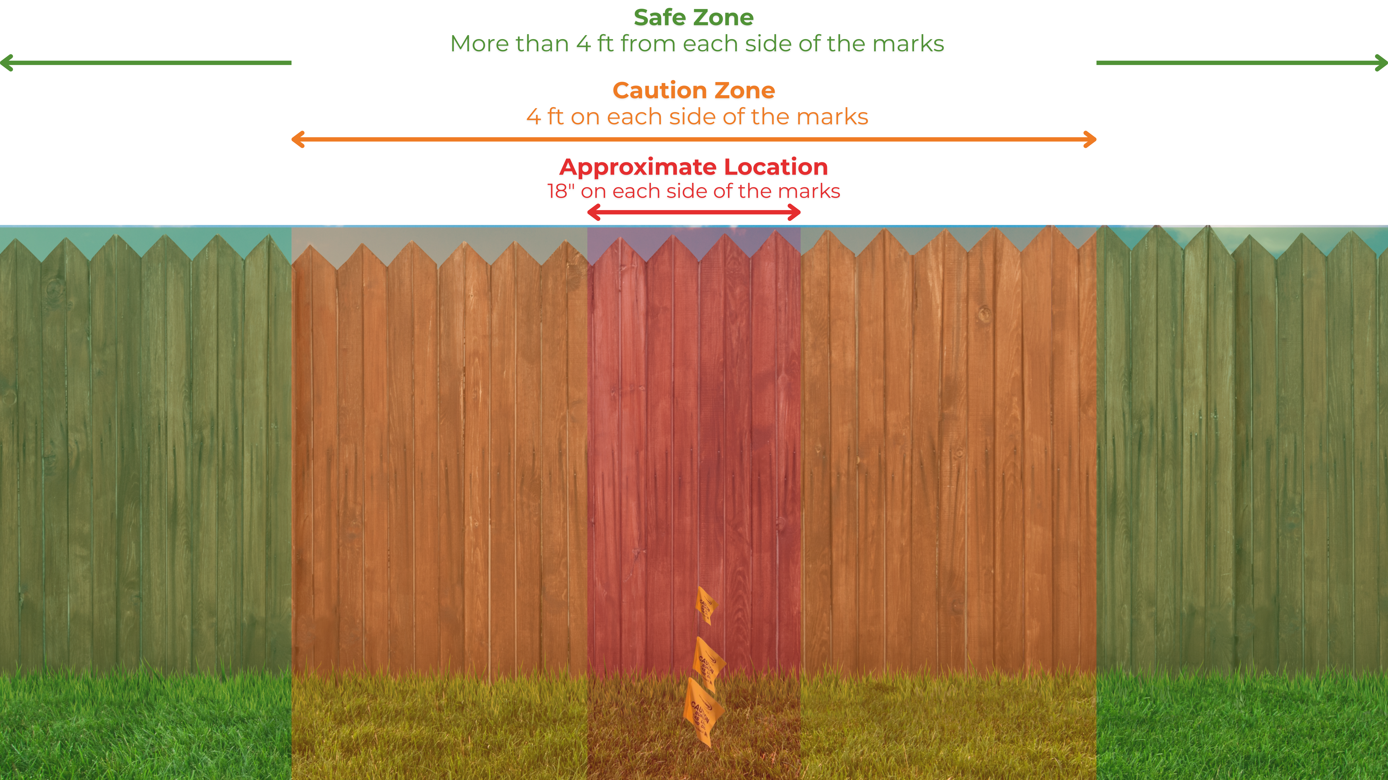
Work Zones & Soft Excavation
Michigan’s excavation law, Public Act 174, requires anyone digging or displacing earth to protect underground utilities by using soft excavation methods when working near facility markings.
Knowing the work zones and when to use soft excavation helps prevent injuries, service outages, and costly damage.

Slide 3

Work Zones & Soft Excavation

Slide 4
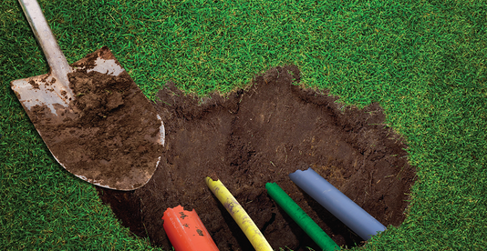
Soft Excavation
When the excavation activity involves the use of power tools, heavy equipment, or machinery, excavators must employ manual excavation techniques when working near facility markings.
Soft Excavation
A method or technique designed to prevent contact damage to underground facilities, which includes, among others:
Digging with hand tools
Digging carefully with non-motorized tools
Pneumatic (Vacuum) excavation
Manual pneumatic tools
Notes:
Soft excavation is a technique used to limit or prevent contact with or damage to an underground facility. By using soft excavation techniques, a person can carefully remove the soil surrounding the facility little by little until the precise location of the facility is completely exposed.

Slide 5

Work Zones
Safe Zone
Area that is more than 4 feet away from either side of the marks.
No hand digging is required.
An excavator can use power tools and equipment in this area.
SAFE
4 FT
4 FT
SAFE
8 FT
Notes:
The safe zone is the area that is more than 4 feet away from either side of the markings.
In this area, digging with hand tools is not required. An excavator may use power tools or equipment in this area.

Slide 6
Work Zones
Caution Zone
Total Area: 8 ft.
4 ft. on either side of the markings
Always start with soft excavation in this zone
You don’t have to use soft excavation to dig up the entire Caution Zone. Start with the Approximate Location.
After you expose the precise location of the facility, you can use power tools or equipment.
4 FT
4 FT
8 FT
Notes:
Caution Zone: This zone is 4 feet out from either side of the marks. In this zone when you dig with power tools or equipment, you are required to use soft excavation techniques to completely expose the facility before you use any of the power tools or equipment.
You do not have to hand dig the entire 8 ft width of the Caution Zone because the locators have marked the Approximate Location.

Slide 7
Work Zones
Approximate Location
Total area of 3 ft.
18” on either side of the marks.
Always use soft excavation techniques in this zone.
Start at 18” from the mark and work towards it.
18 IN
18 IN
3 FT
Notes:
Approximate location: is 18 inches from each side of the markings.
The approximate location is where you should hand dig, so you do not damage the marked facility when you find it. You should be able to find the installation and fully expose it by carefully digging within the 3-foot width of the approximate location.
Make sure to start 18” out from the marks and dig towards it. Digging right on top of the marks could cause damage to the facility.

Slide 8
Work Zones
SAFE ZONE
MORE THAN 4’ ON EITHER SIDE OF THE MARKS
SOFT EXCAVATION IS NOT REQUIRED IN THIS AREA
CAUTION ZONE
4’ ON EITHER SIDE OF THE MARKS
APPROXIMATE LOCATION
18” ON EITHER SIDE OF THE MARKS
Notes:
Approximate location: is 18 inches from each side of the markings.
The approximate location is where you should hand dig, so you do not damage the marked facility when you find it. You should be able to find the installation and fully expose it by carefully digging within the 3-foot width of the approximate location.
Make sure to start 18” out from the marks and dig towards it. Digging right on top of the marks could cause damage to the facility.

