Slide 1
Positive Response
Verifying Utility Marking Status Before You Dig

Slide 2

What is Positive Response?
Excavator places ticket
(phone/online)
MISS DIG 811 notifies Facilities
Facilities / Locators
mark utilities
Facilities / Locators
post to Positive Response
Excavator checks
Positive Response
Facility owners post updates in Positive Response to let you know:
If utilities are marked
If more time is needed
If special instructions apply
Think of it as your stoplight before digging.

Slide 3
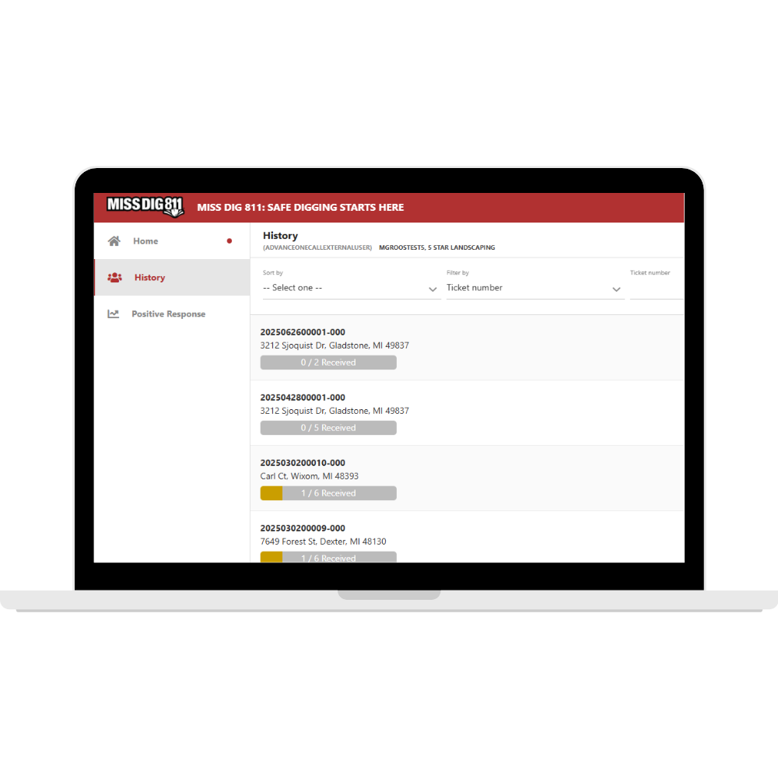

Legal Requirement
Using Positive Response is required by law for both excavators and facility owners/operators.
Digging cannot begin until every facility has responded.
If a facility hasn’t responded by your legal start date, retransmit your ticket so they can mark their utilities.

Slide 4
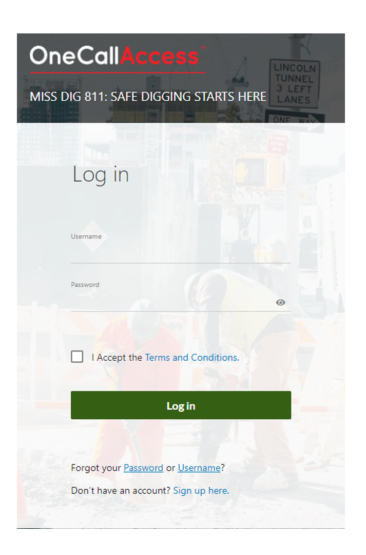
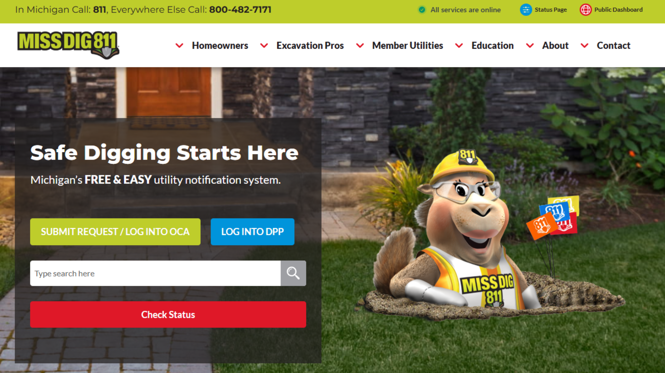
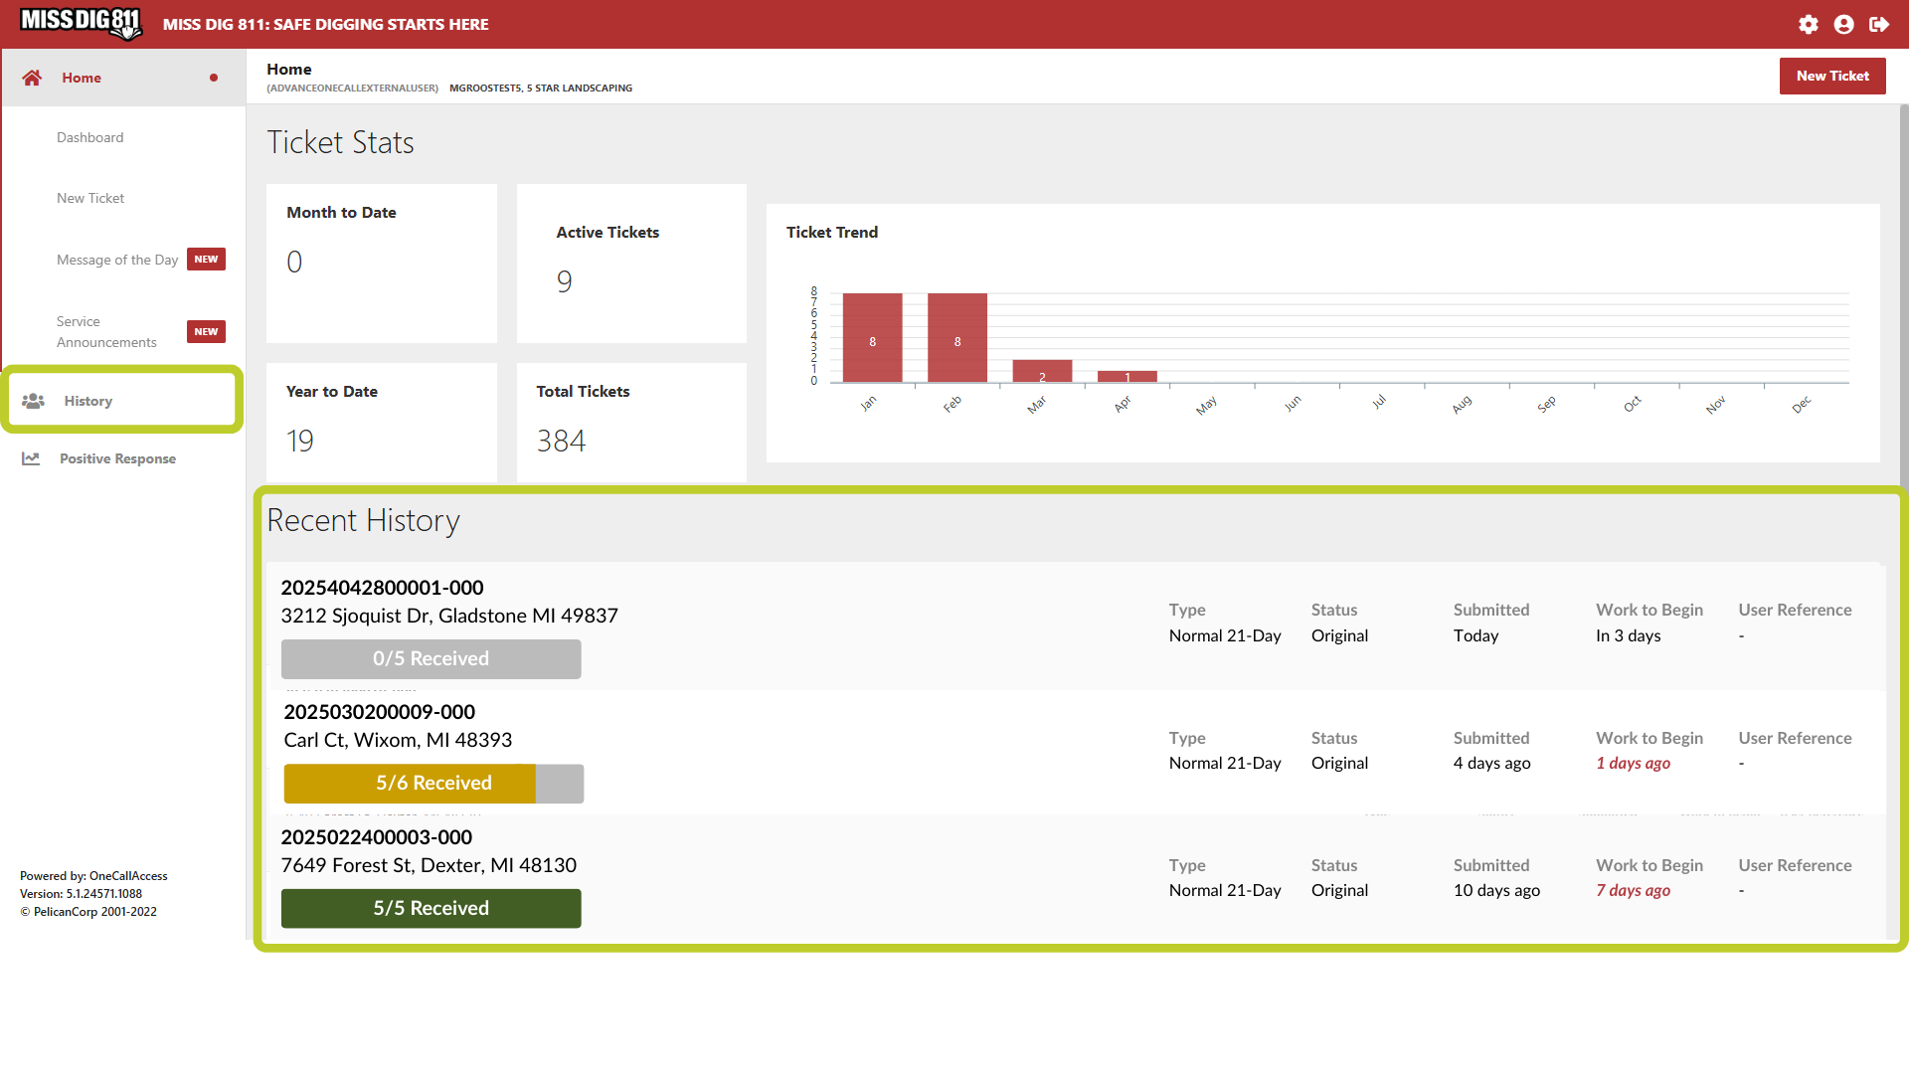
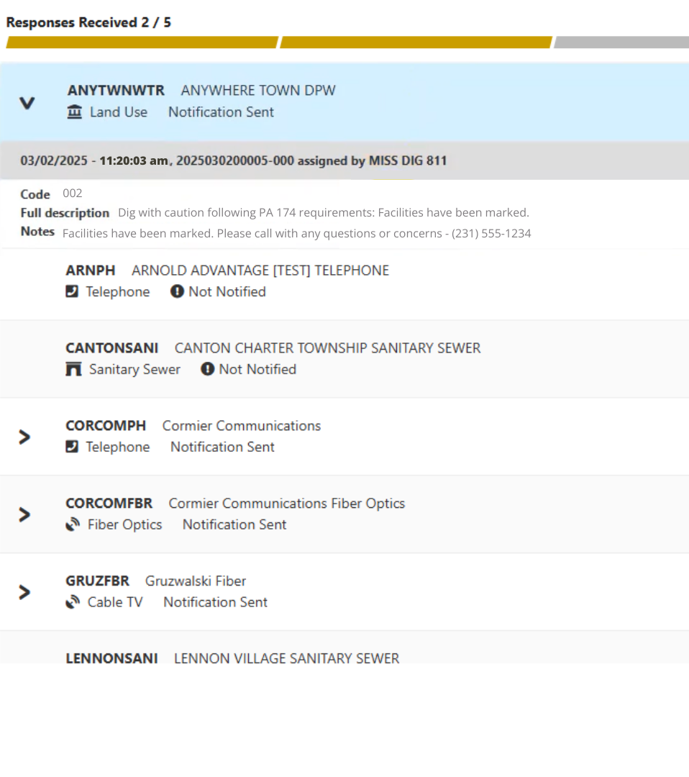

How to Access
Go to missdig811.org and click the red Check Status button.
Log into OneCallAccess.
Go to Recent History or click the History button.
Click each facility to view their response.
Select your ticket.
Note: You can also check Positive Response by going to posr.missdig811.org and entering your ticket number.

Slide 5



Status Bar Colors
Each ticket in OneCallAccess has a status bar.
These show how many facility owners have responded at a glance, but always click through for details.
Green means all responses are in, but you must still check the codes.
Green does not necessarily mean you are clear to dig.
Gray = No responses yet
Yellow = Some responses received
Green = All responses received

Slide 6
Common Response Codes
Facility Owner/Operators or their contract locators post to Positive Response in the form of a response code. Visit missdig811.org for the full list of response codes.
001 – No Conflict
No facilities in area. Safe to dig with caution.
002 – Marked:
Facilities marked. Safe to dig with caution.
003 – Not Complete:
Do NOT dig. More time/coordination needed.
004 – Marked, Utility Required on Site:
Facilities marked. Utility must be present when you dig.
999 – Has Not Responded:
Do NOT dig. Retransmit ticket.

Slide 7
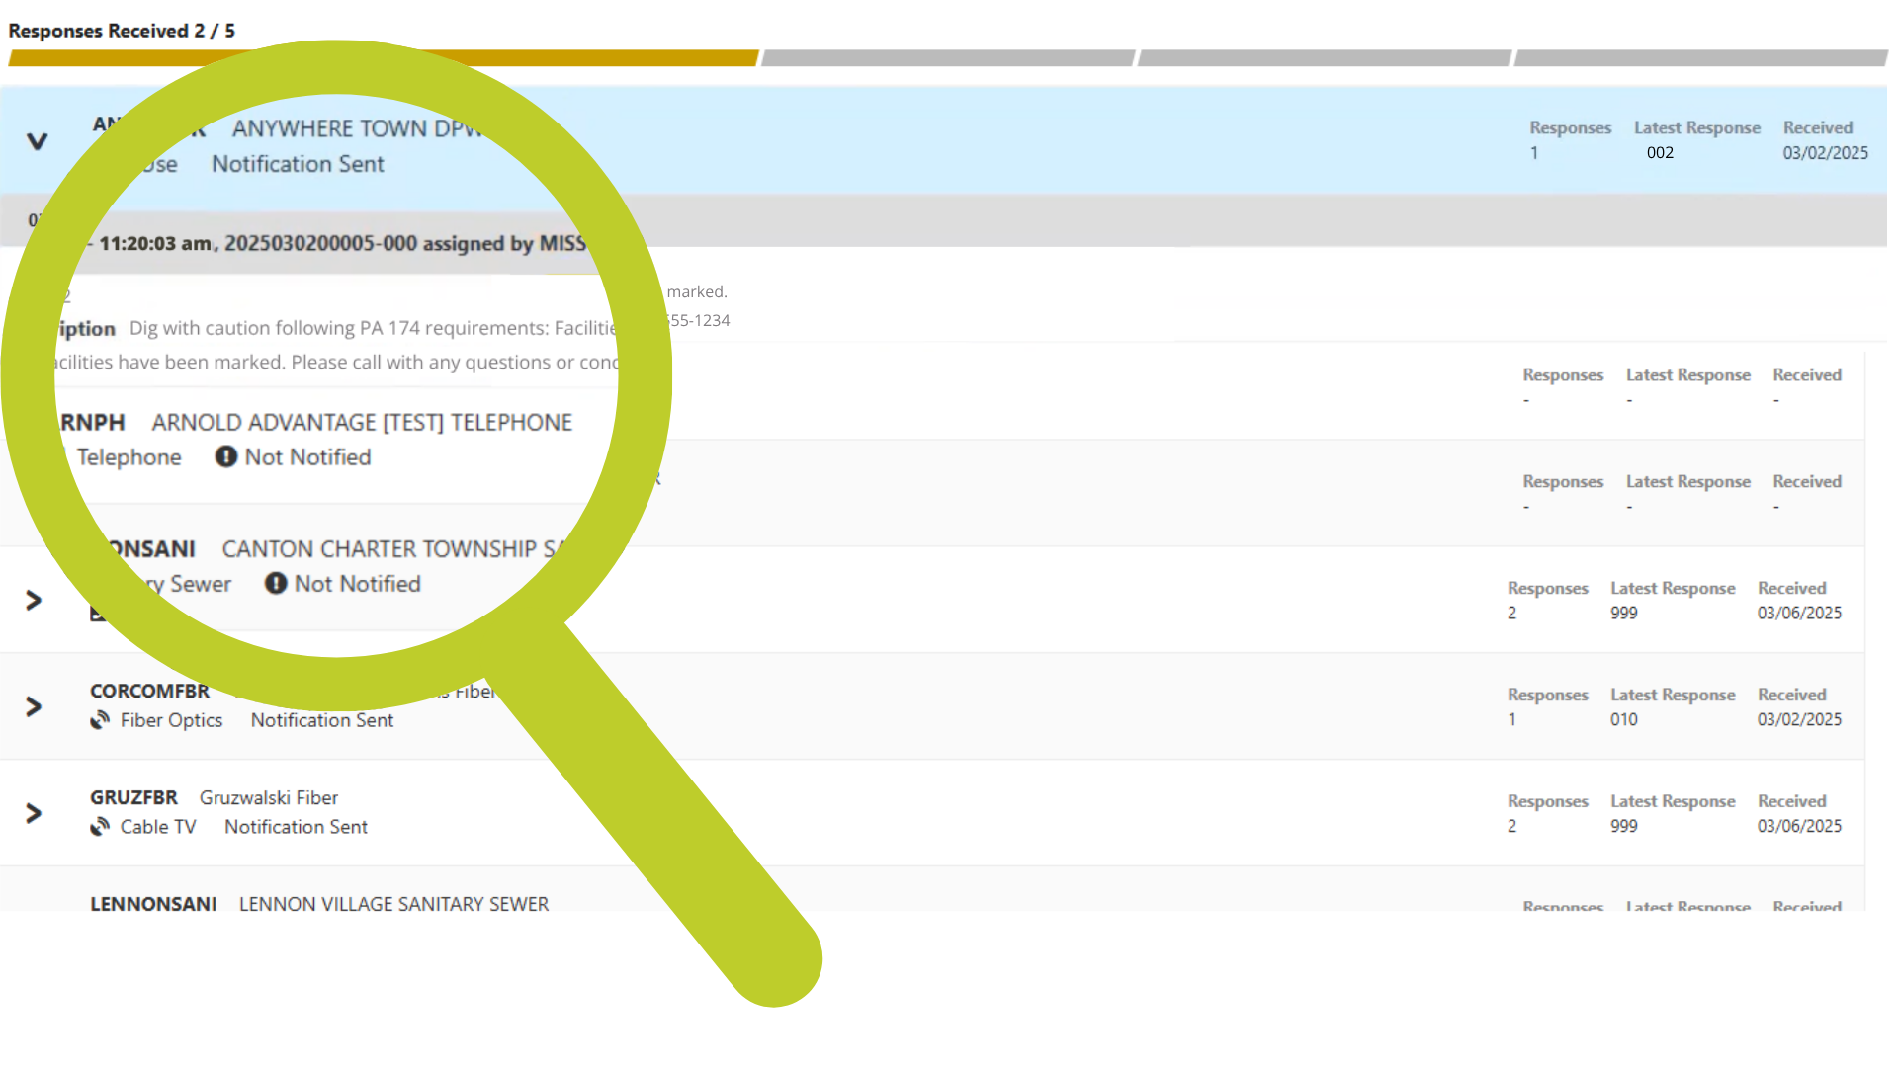
Facility Notes
Facility owners include notes with their responses.
These details can be critical—always read them before digging.

Slide 8
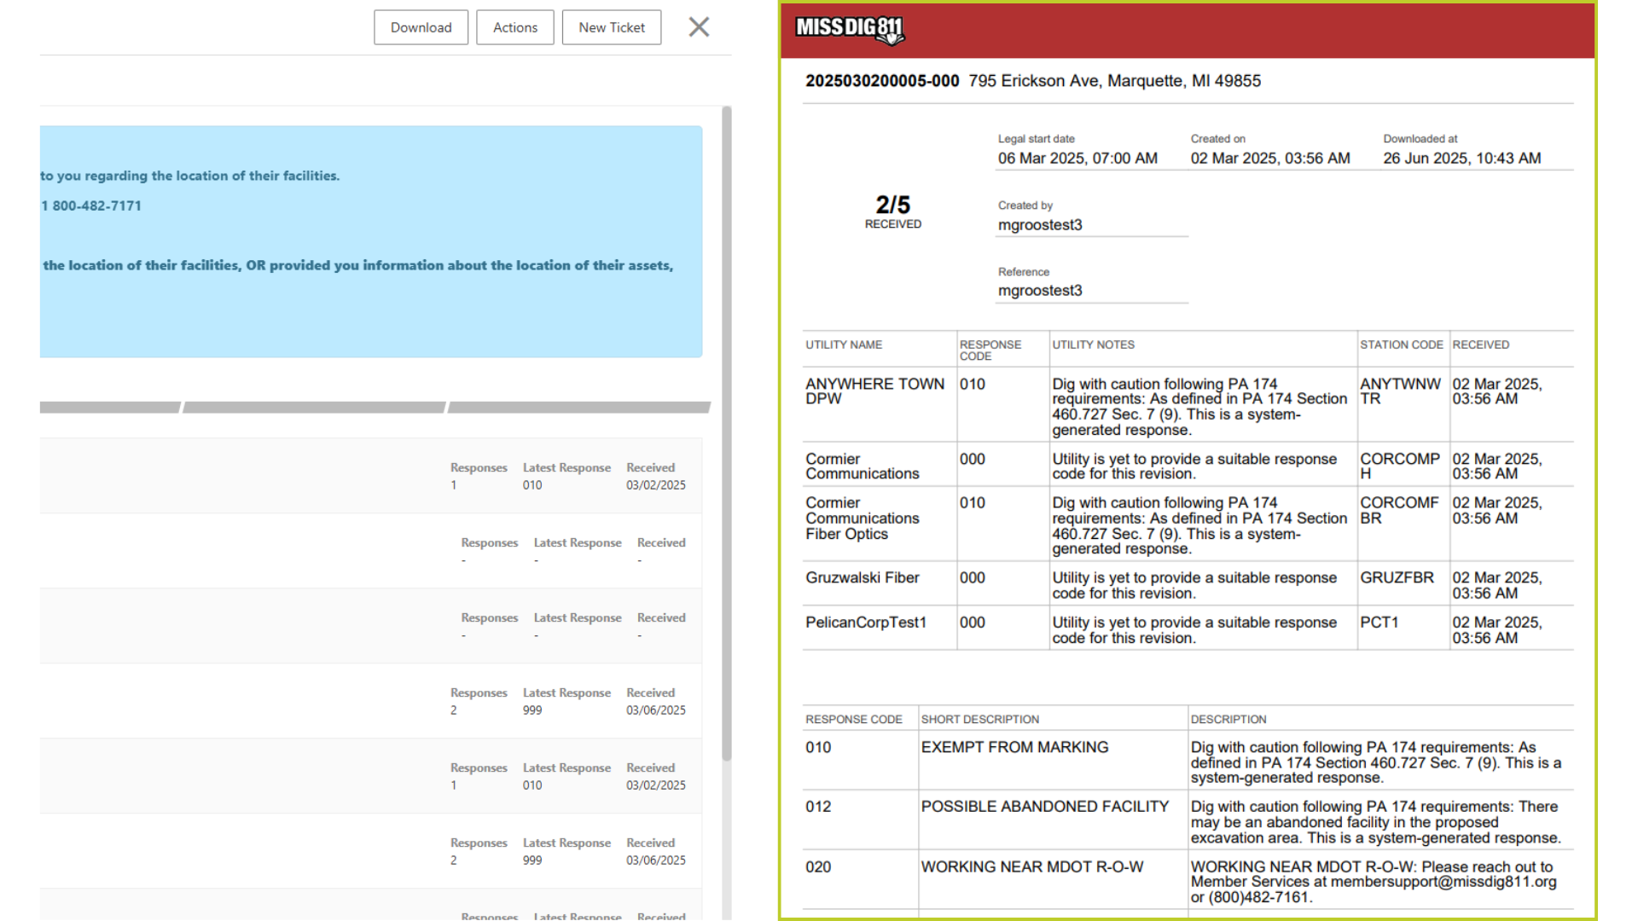
Confirmation Sheet
You can download a Confirmation Sheet and Response Summary for your records.
Always check the online system for the latest updates.

Slide 9
Key Takeaways
Positive Response is required by law
Always check every facility’s response and notes.
The status bar gives a quick glance, but details matter.
When in doubt, contact MISS DIG 811 for help.
Positive Response keeps everyone safe.
Check it every time before you dig.

