Slide 1
Penalties & Liability
What Happens When the Law Isn’t Followed

Slide 2




Penalties for Violating Public Act 174
Misdemeanor
Up to 1 year in prison
Up to a $5,000 fine
Notes:
The MPSC enforces Public Act 174 and can issue the penalties for violations. These can include a misdemeanor charge, up to one year in prison, and/or a fine of up to $5,000 per violation. CLICK

Slide 3
Penalties for Violating Public Act 174
IF YOU…
Knowingly damage underground facility & fail to promptly notify the facility owner/operator.
Knowingly damage facility & conceal damage.
Willfully remove marks, unless work is done, or work removes marks.
Notes:
PA 174 prohibits the following contact: Knowingly damaging an underground facility and failing to notify the facility owner/operator, or trying to conceal the damage, or willfully removing marks. This doesn’t apply if the work is done, or the work itself removes the marks. CLICK

Slide 4

Penalties for Violating Public Act 174
Any party, excavator, or facility owner can file a complaint if they feel that they have suffered a damage due to the non-compliance of another party.
The MPSC requires that some sort of conflict resolution take place between the parties prior to their involvement
MPSC will investigate the claims and can take punitive action against any Michigan stakeholder in violation of Public Act 174
Penalties can be as high as $5,000.00 per violation
Notes:
Someone can file a complaint with the Michigan Public Service Commission if they believe they have suffered harm due to another party's failure to comply.
But first they require that the parties try to resolve the problem themselves.
Afterwards, they will investigate and may take punitive action.
Penalties can reach up to $5,000 per violation and up to one year in prison.

Slide 5

Penalties for Government Agencies
The MPSC employs a tiered penalty approach for excavation violations by government agencies.
1
2
3
If a government agency engages in an activity that violates the requirements of Public Law 174, the MPSC can fine the community up to $5,000 for its first violation.
If a second violation occurs within a 12-month period, the fine may increase to $10,000 and safety training may be required for staff.
If a third violation occurs within a 12-month period, the government agency could face fines of up to $15,000 and could also lose any government immunity invoked to avoid payment of claims for repair of damage to the facilities.
Notes:
The MPSC employs a tiered penalty approach for excavation violations by government agencies. This could be a city or township that is not following PA 174.
If a government agency engages in an activity that violates the requirements of Public Law 174, the MPSC can fine the community up to $5,000 for its first violation.
If a second violation occurs within a 12-month period, the fine may increase to $10,000 and safety training may be required for staff.
If a third violation occurs within a 12-month period, the government agency could face fines of up to $15,000 and could also lose any government immunity invoked to avoid payment of claims for repair of damage to the facilities.

Slide 6
Who Is Liable When Damage Occurs?
The excavator is responsible for protecting underground facilities once marks are placed.
If damage occurs on an expired ticket, or without contacting 811, the excavator is treated as if no ticket was ever placed.
Facility owners are responsible for accurate marking within 3 business days.
If a facility is unmarked or improperly marked, the facility owner/operator may bear liability.
MISS DIG 811 does not mark lines and is not liable for damages.

Slide 7
Common Situations That Shift Liaiblity
Expired Ticket:
Excavator assumes full responsibility for any damage.
Digging Before Positive Response is complete:
Excavator is liable.
Marks destroyed and no Retransmit requested:
Excavator is liable.
Inaccurate or missing marks:
Facility owner/operator may be liable.
Digging without soft excavation in the Caution Zone:
Excavator is liable.

Slide 8
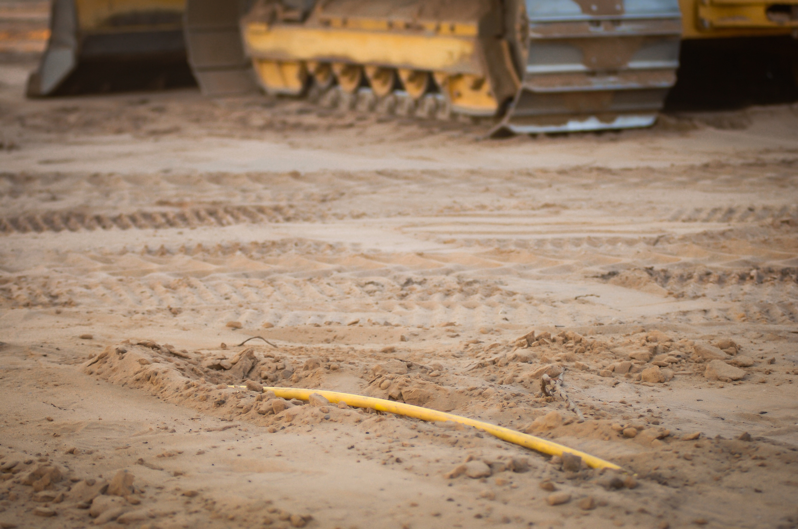
Damage Reporting Requirements
Excavators must immediately notify the facility owner/operator of any contact or damage.
Excavators must stop work in the area until the utility evaluates and repairs the facility.
Failure to report damage is a citable offense under PA 174.
Not reporting or concealing damage increases penalties and can lead to misdemeanor charges.

Slide 9

How to Avoid Liability
Always contact MISS DIG 811 before digging.
Wait for all utilities to respond in Positive Response.
Use soft excavation within 4 feet of marks.
Protect exposed lines (support, bracing, safe trench practices).
Keep marks visible; request retransmits when faded or destroyed.
Stop work and request Additional Assistance if something looks wrong.

