Slide 1
Placing a Ticket
Always contact MISS DIG 811 before you dig!
It’s the first step in safe excavation.

Slide 2



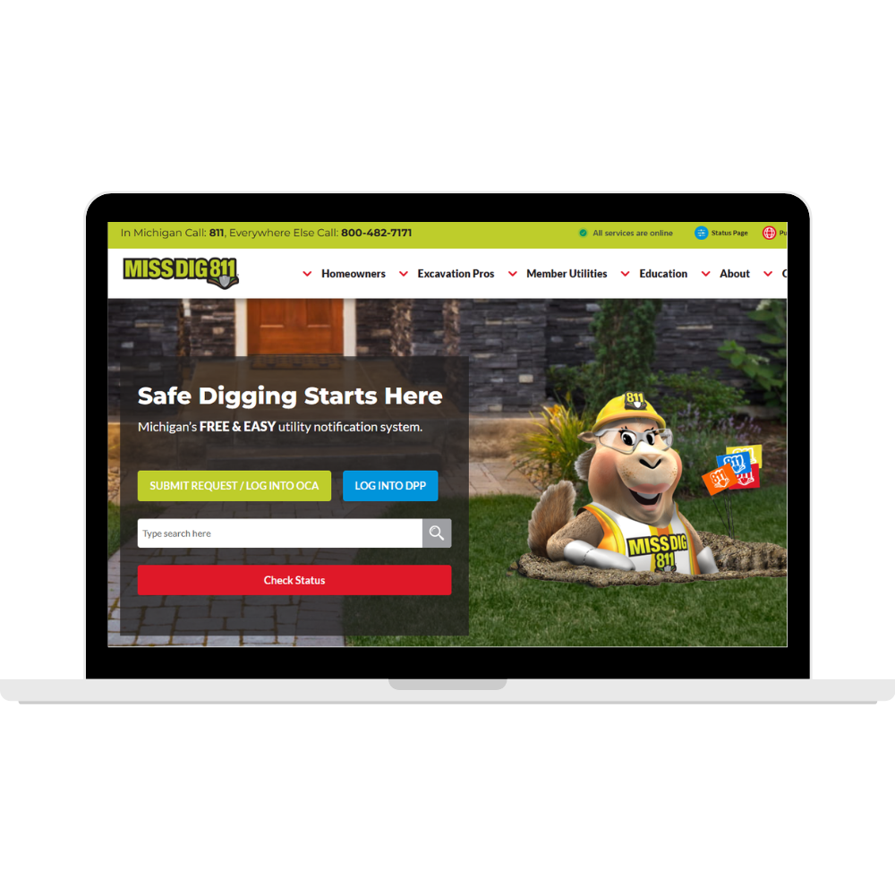
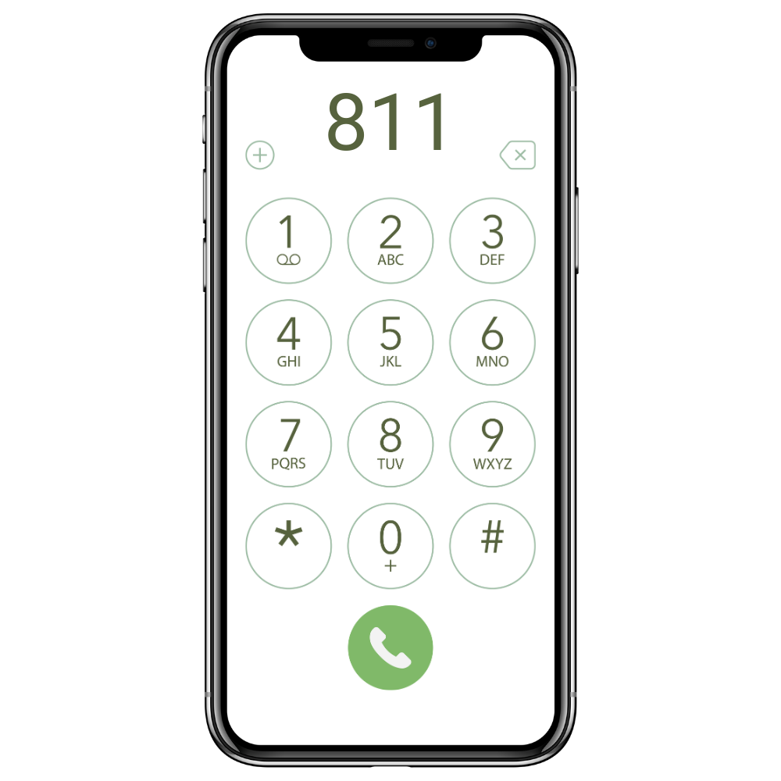
When to Place a Ticket
Before starting a project, contact MISS DIG 811.
At least 3 business days before starting
Maximum of 14 calendar days before starting
SUN | MON | TUES | WED | THUR | FRI | SAT
 |  | 1 | 2 | 3 | 4 | 5
6 | 7 | 8 | 9 | 10 | 11 | 12
13 | 14 | 15 | 16 | 17 | 18 | 19
20 | 21 | 22 | 23 | 24 | 25 | 26
27 | 28 | 29 | 30 | 31

Slide 3
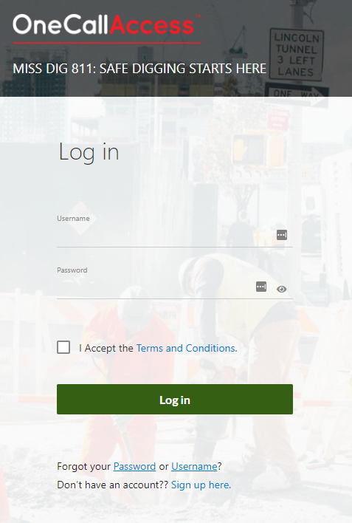

Placing a Ticket Online
Click “Submit Request” at missdig811.org
Log into OneCallAccess
Select “New Ticket”

Slide 4
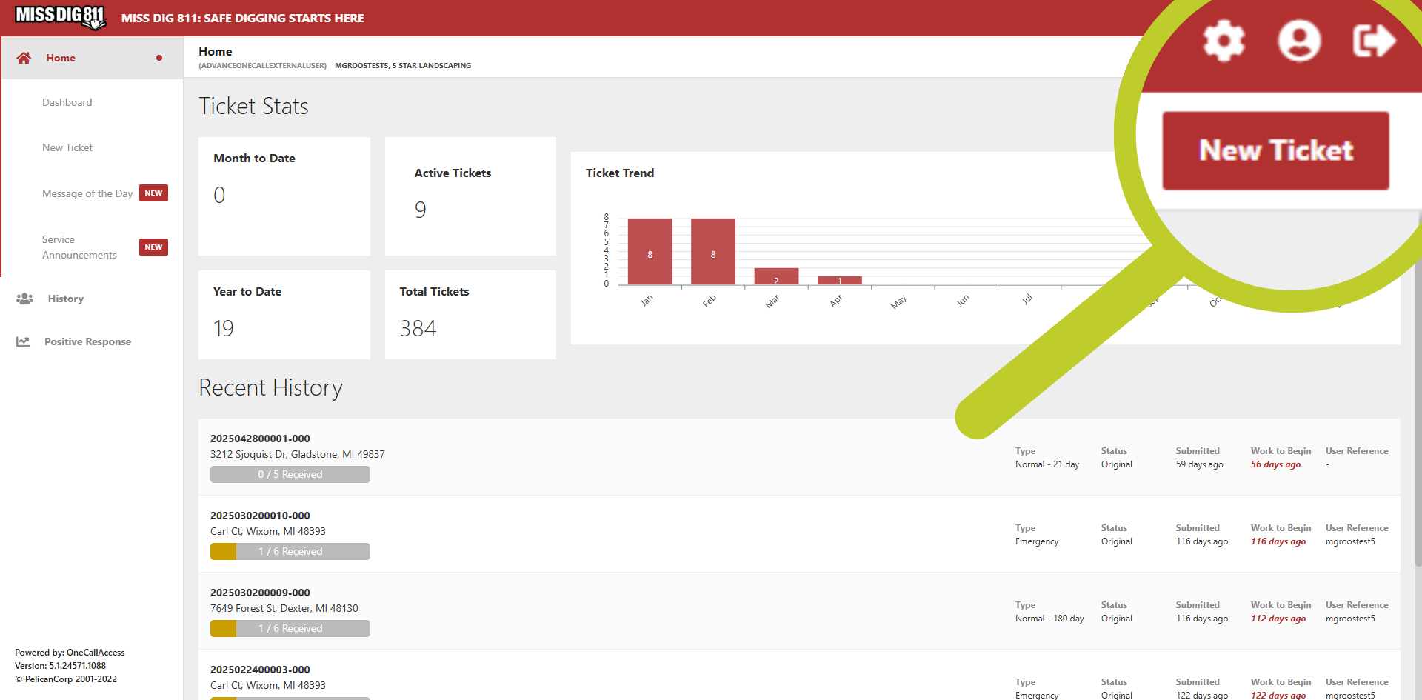
Placing a Ticket Online
Click “Submit Request” at missdig811.org
Log into OneCallAccess
Select “New Ticket”
Notes:
Then, click “New Ticket” in the upper right-hand corner of the page. CLICK

Slide 5
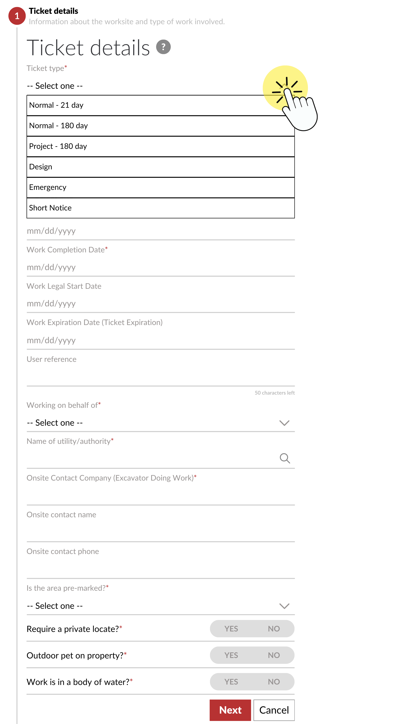
Ticket Type
21-Day Tickets
Projects taking 21 days or less to complete
Most single address tickets are 21-Day Tickets
May be placed by all users
180-Day Tickets
Projects taking more than 21 days of digging to complete.
Not a substitute for not knowing when your project will start.
May be placed by External Plus users and Notification System Representatives.

Slide 6
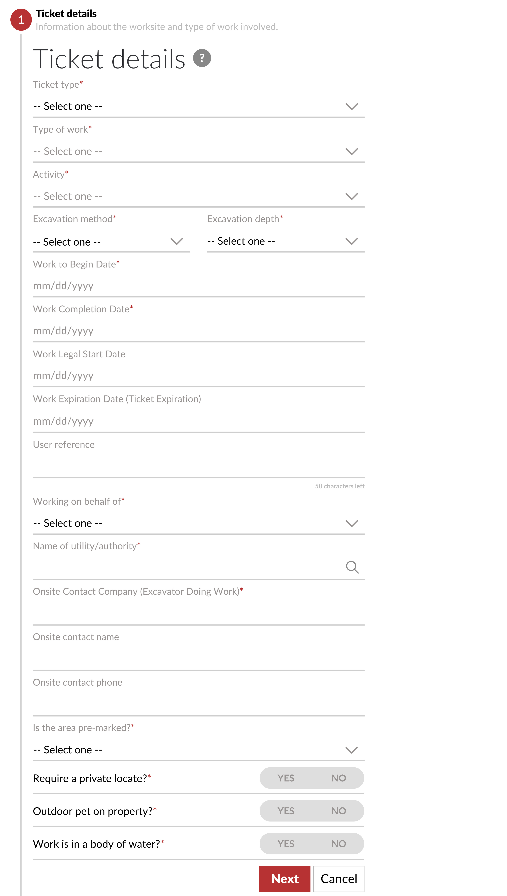

Ticket Details
Fill out the rest of the ticket details, including:
Type of Work & Activity
Excavation Method & Depth
Start & End Dates
Onsite Contact Info
Click “Next” to continue

Slide 7
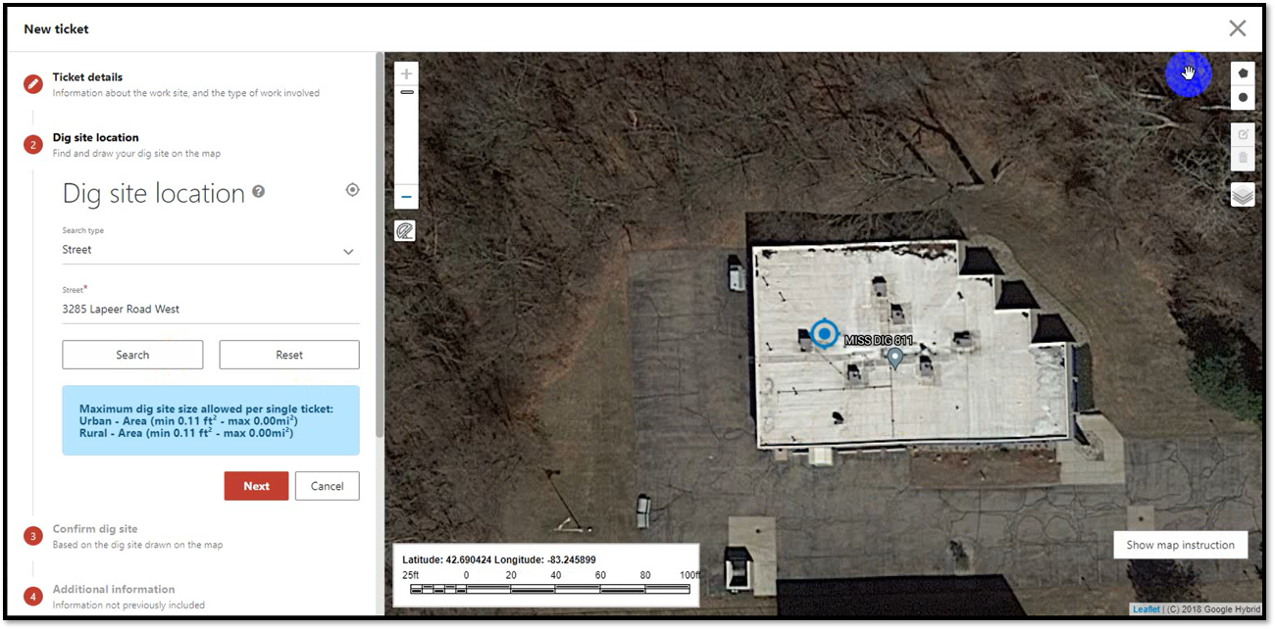
Search For Your Dig Site
Select the polygon tool.
Draw dig site as accurately as possible.
Search by address, intersection, or GPS coordinates
Digging that takes place outside of your polygon is not covered under PA 174!

Slide 8
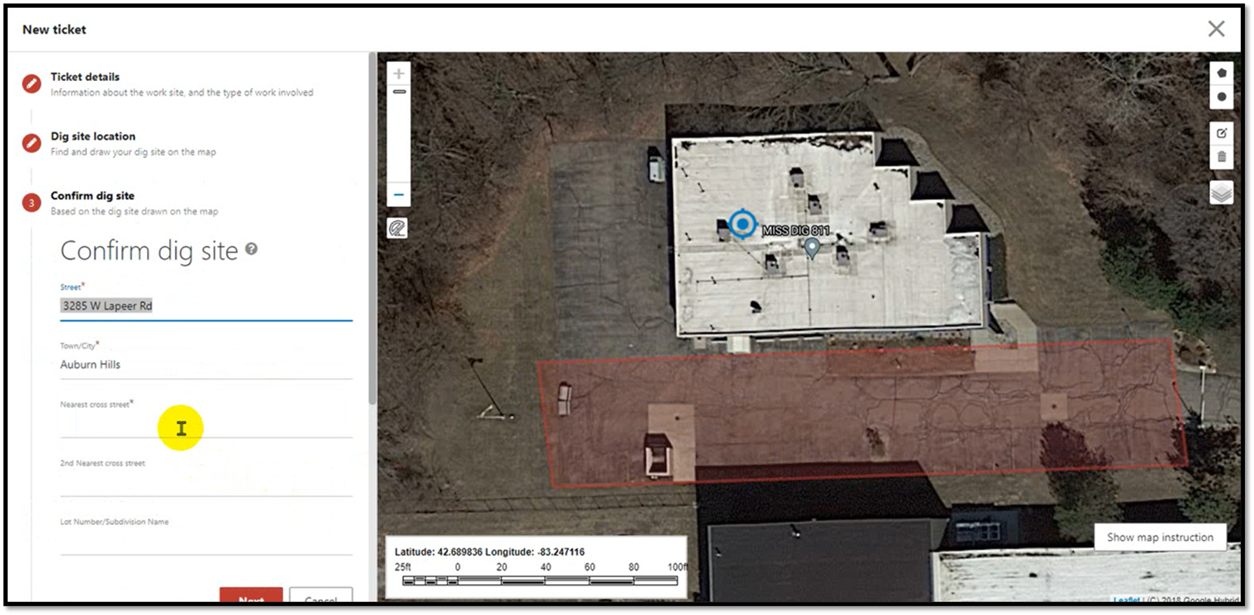
Confirm Dig Site & Add Cross Street(s)
Make sure address is accurate
Enter 1-2 nearest cross streets

Slide 9
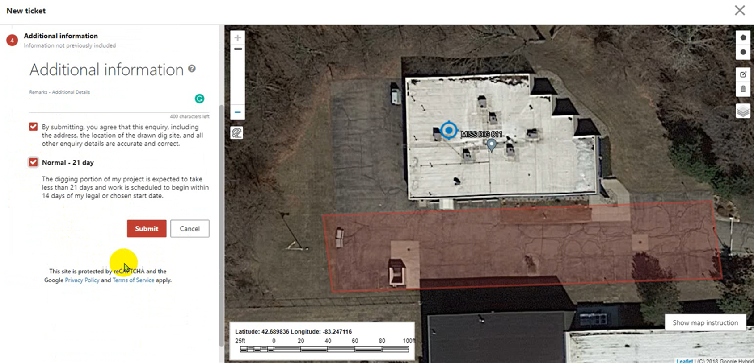
Additional Information
Provide any useful info for facility owners & locators about the job site.
If polygon accurately represents the job site, enter “SEE POLYGON”
Check the agreement boxes & click “Submit”
Notes:
In the “Remarks-Additional Details” field, provide any useful information for facility owners and locators about the job site. If the polygon accurately represents the job site, enter “SEE POLYGON”. Check the agreement check boxes and click Submit. CLICK

