Slide 1
Excavator Responsibilities
Required Steps for Safe and Compliant Excavation

Slide 2
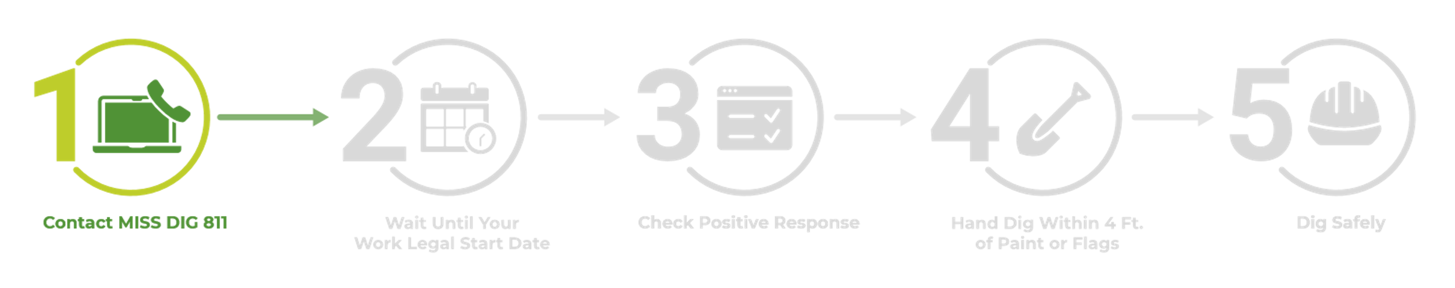

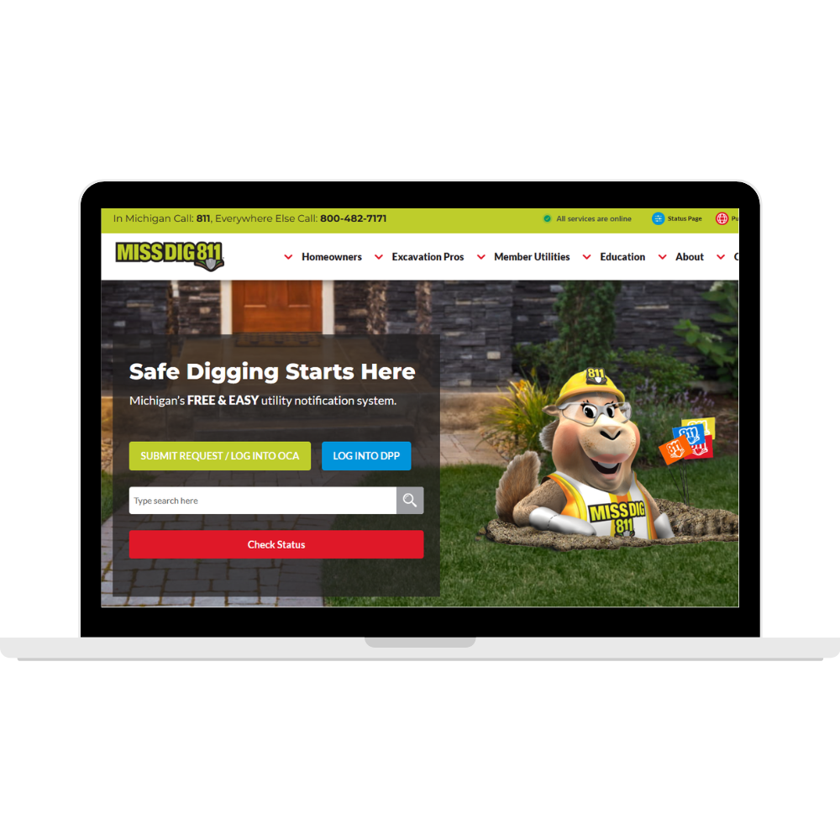
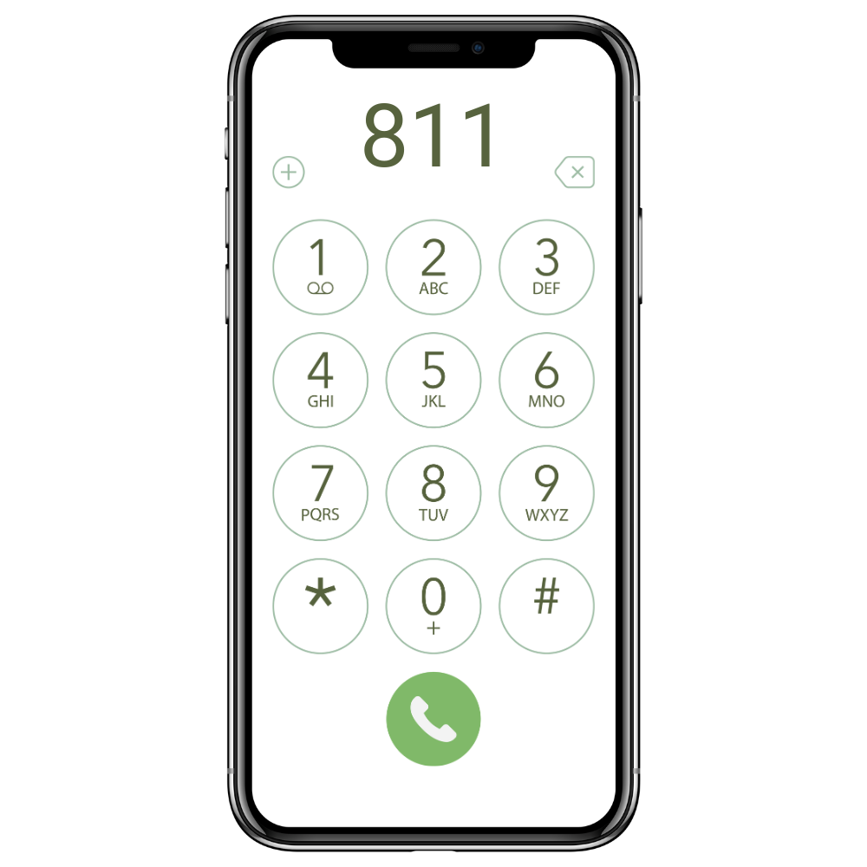
Role of the Excavator
Contact MISS DIG 811
Online at missdig811.org or call 811
Submit at least 3 business days before digging
Be prepared with work type, address & dig area
Keep your confirmation sheet with ticket number
Notes:
The first step is to contact MISS DIG 811 before digging or displacing earth.
Tickets can be placed online at missdig811.org or by calling 811.
Tickets must be submitted at least 3 business days before the project is scheduled to begin.
It’s important to provide accurate information so utilities mark the correct area.
Keep your confirmation sheet. It includes your ticket number, which you’ll need later to check Positive Response.

Slide 3
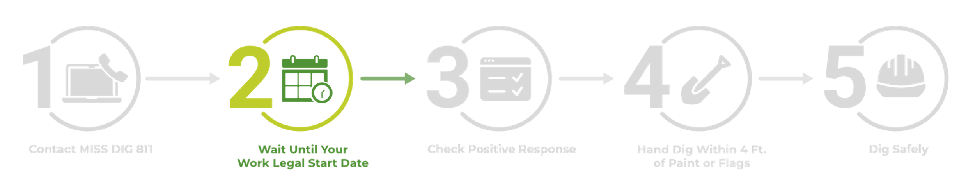

Role of the Excavator
Wait Until Your Work Legal Start Date
MISS DIG 811 does not mark lines
Utilities mark lines and record status in Positive Response by your Work Legal Start Date
Minimum of 3 business days.
Private lines aren’t marked
Private Locators can be hired
Notes:
After placing a ticket, the next step is waiting for the Work Legal Start Date.
This is the earliest date and time you are legally allowed to begin excavation.
MISS DIG 811 does not mark lines—facility owners or their contract locators perform all marking.
They have 3 business days to mark and update Positive Response.
Remember: private lines are not marked through MISS DIG 811. If private facilities may be present, a private locator should be hired.

Slide 4
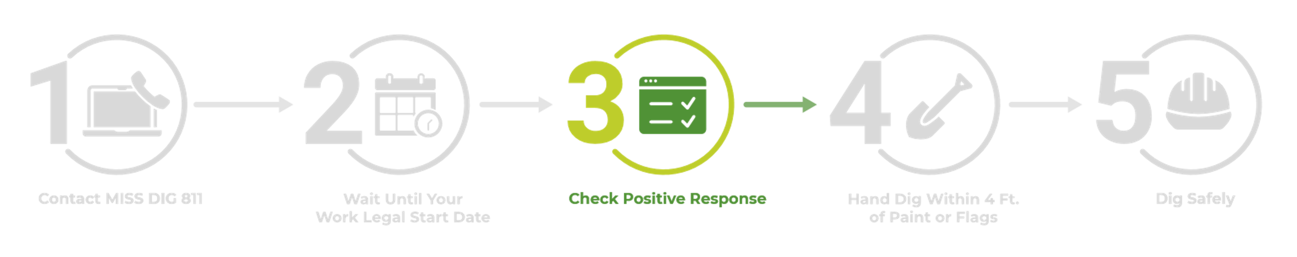
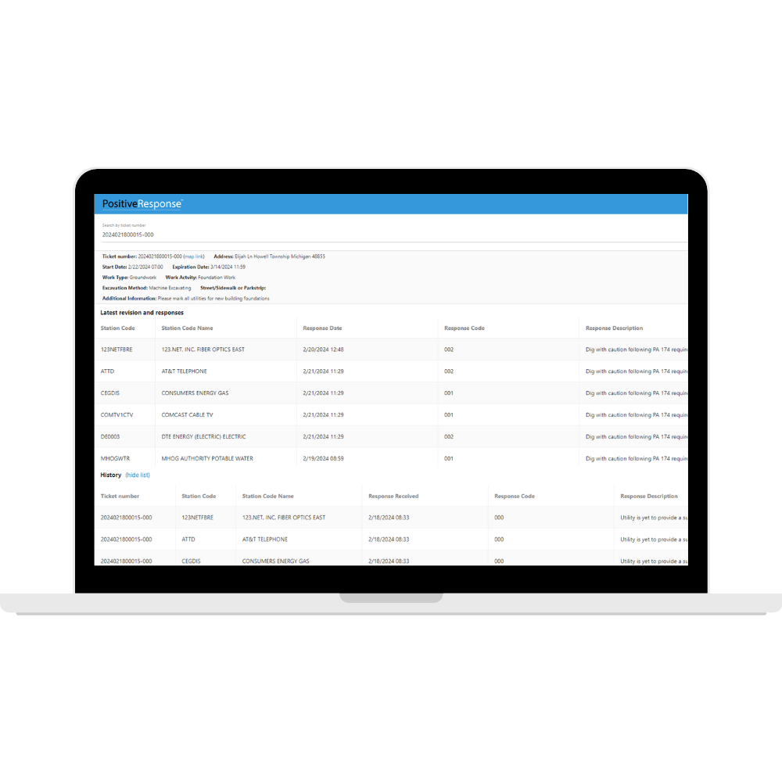
Role of the Excavator
Check Positive Response
After Work Legal Start Date has arrived, check Positive Response.
Click Check Status at missdig811.org
Confirm all utilities have responded.
All utilities must show Marked / No Conflict / Exempt
If any no response or missing marks → call 811
You can also check Positive Response at posr.missdig811.org.
Notes:
Once your Work Legal Start Date arrives, you must check Positive Response before you dig.
You can access it from the MISS DIG 811 website (“Check Status”) or directly at posr.missdig811.org.
Look for responses like Marked, No Conflict, or Exempt from every utility.
If any utility has not responded, or if marks appear missing or incomplete, stop and contact 811.
Digging without full utility responses shifts liability to the excavator—even if marks later turn out to be wrong.

Slide 5
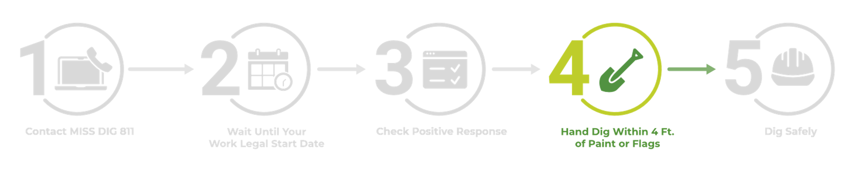
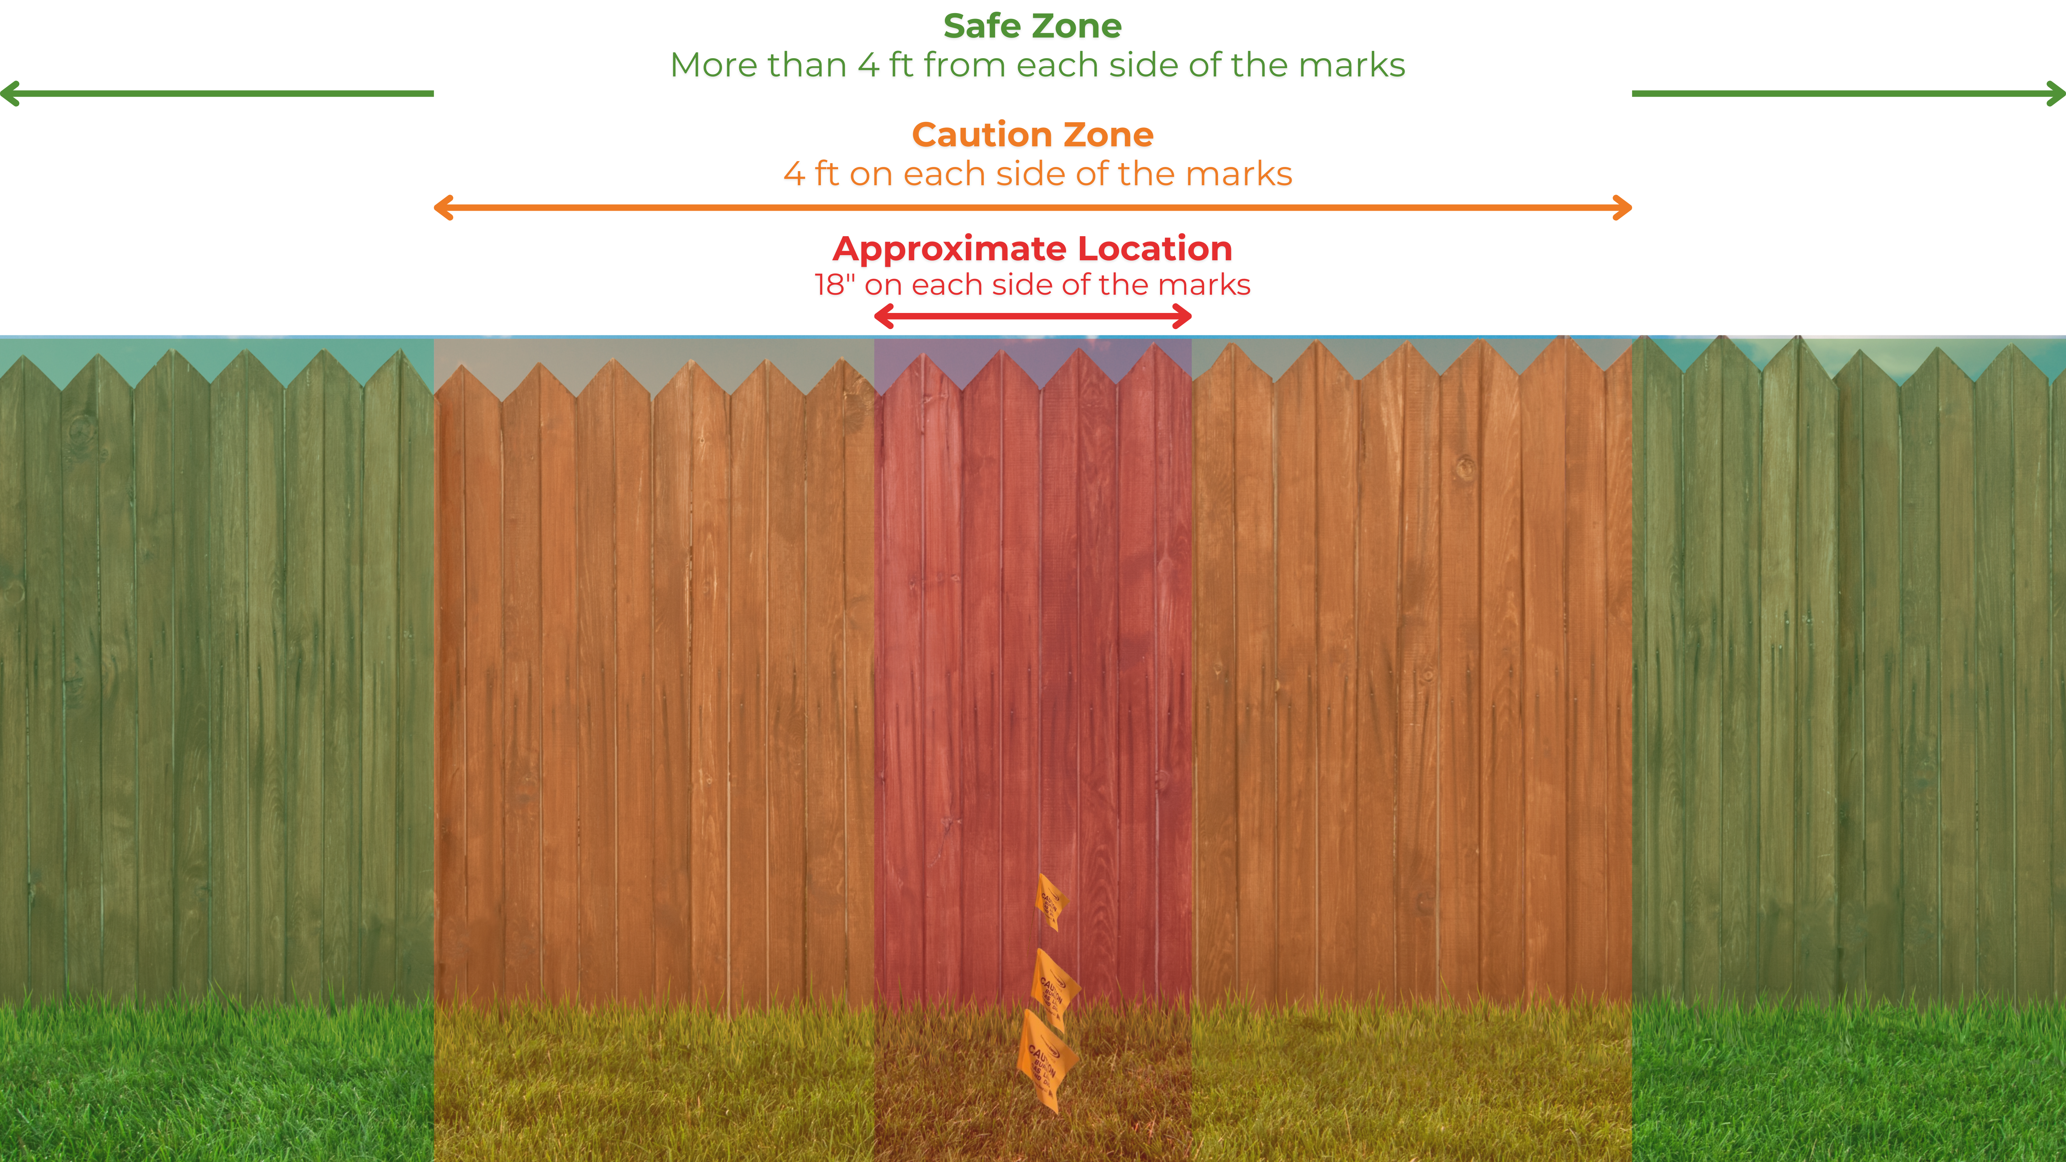
Role of the Excavator
Hand Dig Within 4 Ft. of Paint or Flags
Within 4 ft of marks = hand dig / use soft excavation
Beyond 4 ft = no need to hand expose
Unclear/missing marks? Request retransmit
Notes:
Within 4 feet of paint or flags, excavators must use hand digging or soft excavation methods.
This is required to safely expose utility lines and prevent accidental damage.
Outside of 4 feet, power tools and equipment may be used without hand exposing.
If marks are unclear, missing, or appear incorrect, request a retransmit.
Markings can fade quickly, especially in weather or high-traffic areas—don’t assume they’re still valid.

Slide 6
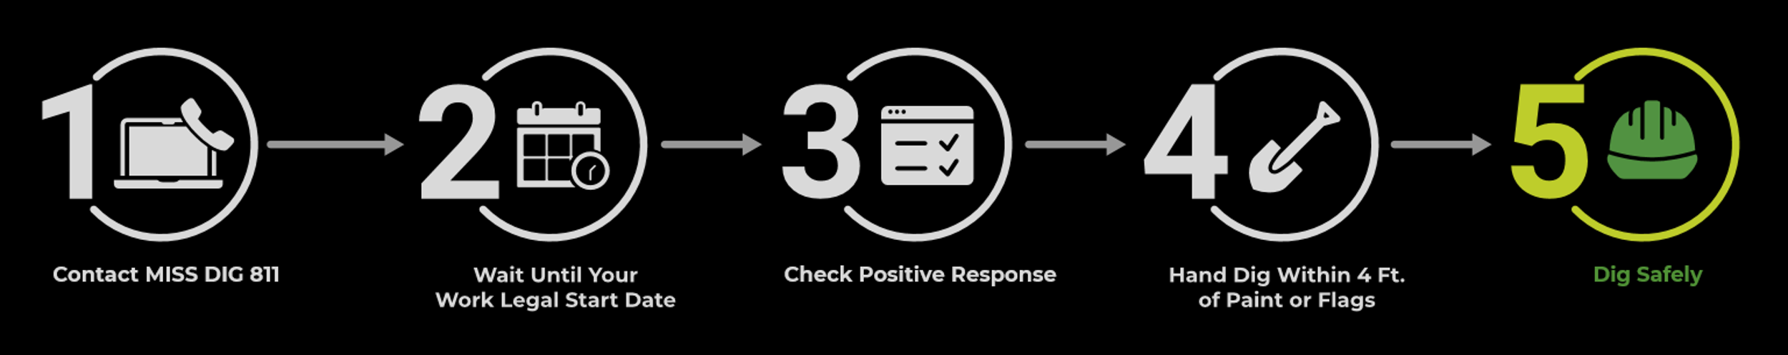
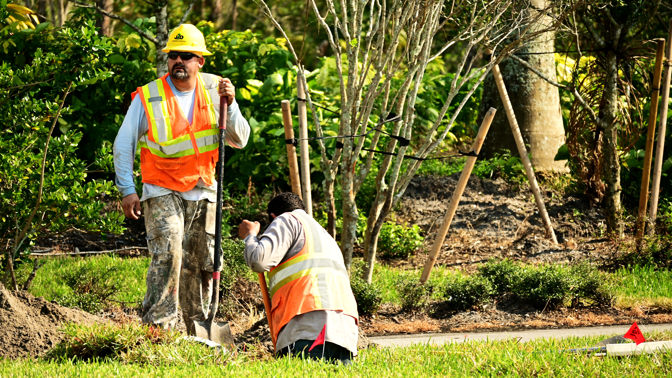
Role of the Excavator
Dig Safely
Continue carefully after exposing lines
Keep flags/paint until done or ticket expires
Need help? Contact MISS DIG 811
Notes:
Once underground lines are exposed, the excavator is responsible for protecting them.
Keep all paint and flags in place until the work is complete or the ticket expires.
Continue digging cautiously and monitor for any hazards or unexpected lines.
If something doesn’t look right—missing marks, mismatched utilities, unmarked facilities—stop work and contact MISS DIG 811 for assistance.
Following these steps protects workers, utilities, and the public—and keeps your worksite compliant with PA 174.

