Slide 1
Emergency Tickets
Understanding Emergency Excavation Under PA 174

Slide 2
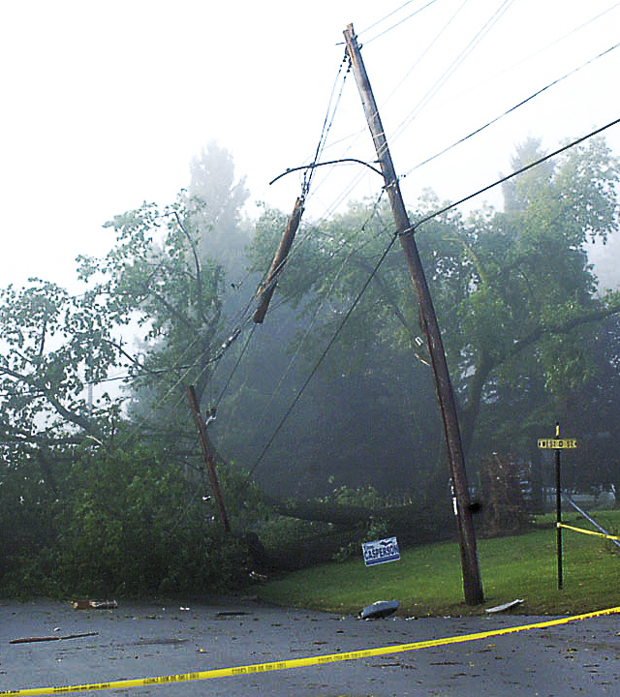
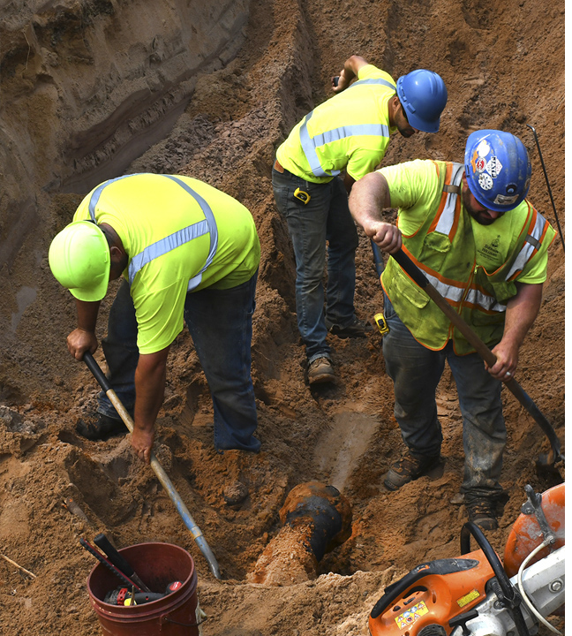
Emergency Tickets
When a member receives notification of an emergency ticket,
the mandatory response time is 3 hours.
Emergency
A sudden or unforeseen occurrence, including a government-declared emergency, involving a clear and imminent danger to life, health, or property, or imminent danger to the environment, that requires immediate correction in order to restore or to
prevent the interruption of essential governmental services, utility services, or the blockage of public transportation and that requires immediate excavation or blasting.
Must be a valid reason.
Excavator notifies the Facility Owner/Operator if they damage a line.
Repair crew places the emergency ticket since they will be doing the work.
Notes:
When a member receives notification of an emergency ticket, the required response time is 3 hours.
CLICK
The definition of an emergency according to PA 174 is: A sudden or unforeseen event that requires immediate repair or replacement to restore or prevent the interruption of essential government services, public utilities, or the blockage of public transportation and that requires immediate excavation or blasting. CLICK
Emergency Tickets must be placed due to a valid reason. CLICK
Excavator notifies the Facility Owner/Operator. CLICK
Repair crew places the emergency ticket. CLICK

Slide 3
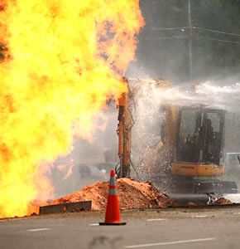
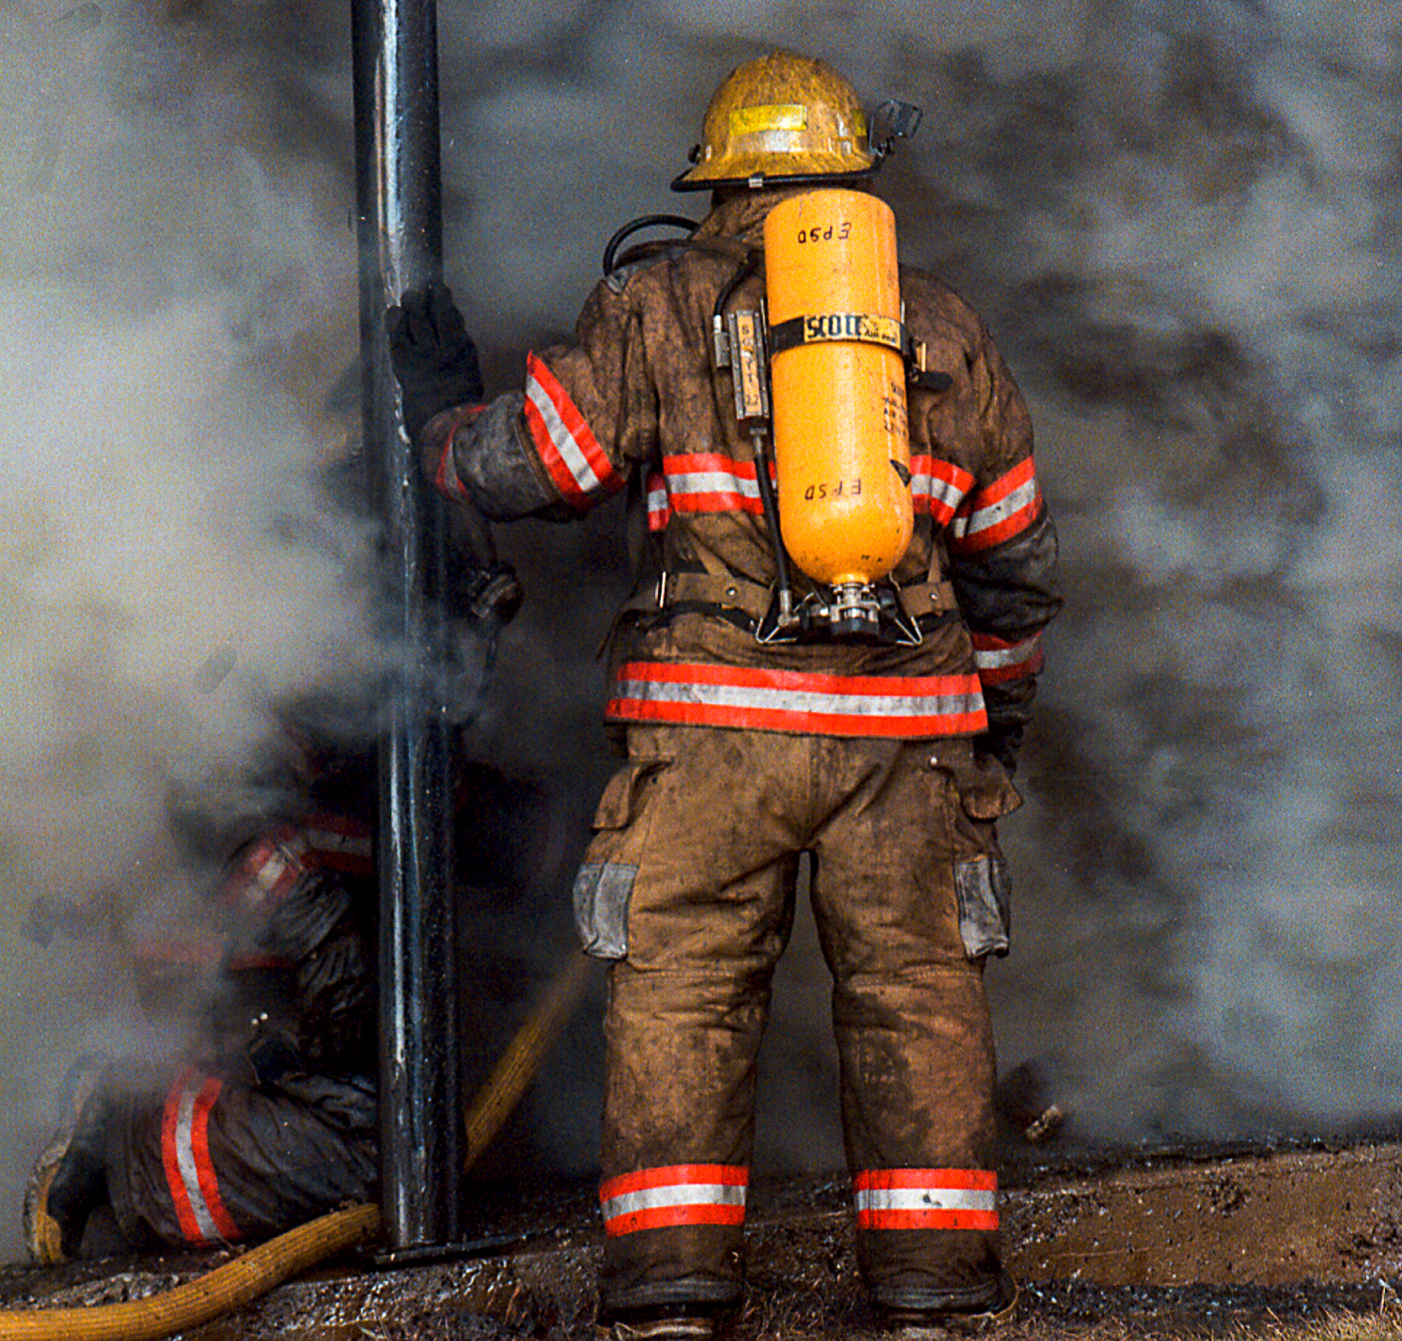
If An Emergency Occurs…
Evacuate Work Area And Surroundings
Call 9-1-1
Evacuate Occupants Of Buildings At Risk (Leave Doors Open)
Do Not Return To Building
Do Not Operate Light Switches, Doorbells, Or Use Telephones Within Building
Keep People Away From Leak
Prohibit Smoking
Keep machinery shut down
Contact the facility owner/operator for assistance.

